Slide 1

Methodology for Regional Cooperation
Marcello Colledani - AFIL, Lombardy Region cluster on Intelligent Factory

Slide 2
The four steps of the SCREEN project
How to identify local Circular Economy potential and existing Value Chains
(Regional level)
How to identify cross-regional
Circular Economy Synergies
(Operational synergies)
How to finance projects raising from cross-regional synergies
(Funding synergies)
How to assess the “circularity” of one project with respect to another one
(Assessment Criteria)
METHODOLOGY FOR REGIONAL COOPERATION
POLICY MAKERS RECOMMENDATION MANUAL

Slide 3
SCREEN Methodology: From local to cross-regional value-chains
Data Collection: A tool has been designed to collect data about existing capabilities in the Screen Regions, also considering the Smart Specialization Strategies and the key industry sectors.
Analysis: A twofold data-driven and interaction-driven approach has been followed in order to analyse the existing capabilities and identify the existence of regional hotspots and cross-regional opportunities and emerging ideas.
Synthesis: The existing cross-regional value-chains have been formalized and specific opportunities that can potentially result in actions to be implemented through cross-regional cooperation have been formalized.

Slide 4

Data Collection: SCREEN Mapping tool
1. RIS3, strategic areas, and SWOT Analysis
Strategy
2. Focus Sectors & Companies
3. Capabilities overview:
R&D, Innovation, Education capabilities
Mapping
Baseline Situation
Innovation
Explicit Emerging Actions
4. Emerging ideas
5. Existing Circular Economy legislation
Barriers and Funding opportunities
6. Existing funding instruments
These steps have been formalized within the SCREEN tool. The Regions have compiled the tool and this has been the basis for the local and cross-regional analyses

Slide 5
Data Driven Analysis
Starting from the tool inputs a data-driven analysis of the potential cross-regional value-chains (sector-driven, material-driven) has been carried out.
Transport and mobility value-chain.

Slide 6
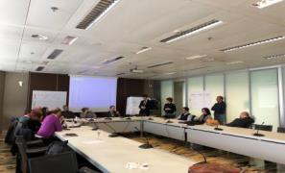
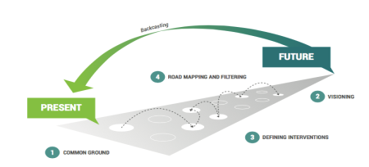
SCREEN workshops
Starting from the tool inputs and data analysis, value-chains have been further analyzed through international and local workshops.
SCREEN Local workshop held in the Lombardy Region on November 2017, on the “Circular value chain for the automotive sector”
Potential synergies with other Regions have been highlighted

Slide 7
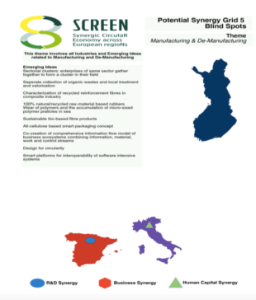
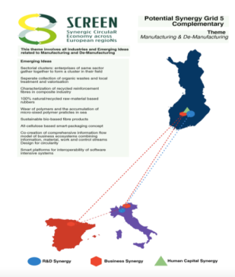

SCREEN Cross-regional value chains
Starting from the tool inputs, local and consortium workshops, the cross-regional synergies have been identified.
Example of cross-regional value chain for the “Manufacturing and Remanufacturing” sector among Tampere (Finland), Lombardy (Italy) and Navarra (Spain)

Slide 8
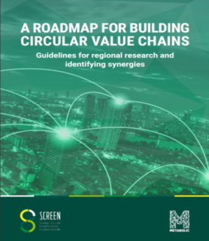
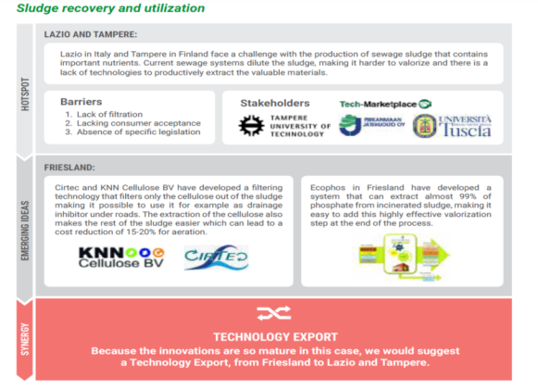
SCREEN Cross-regional cooperation projects

Slide 9
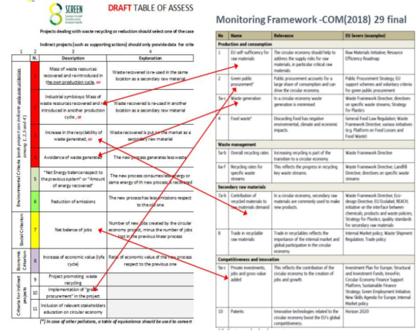
Assessment criteria for circular economy projects
Conceived to be added to the already existing criteria
Easy to be used by both applicants and evaluators
Allows an actual comparison (with figures!) of different kinds of circular economy projects
Positively Checked by 165 European stakeholders through an online questionnaire
www.screen-lab.eu/Step4.html
Implemented in an independent way, but actually complying with the Monitoring Framework indicators

Slide 10
Existing financial instruments
”Existing financial Instruments” have been revised including the instruments already available in the regions which are mapped to:
Further develop the emerging ideas, stemming from the results of the previous steps within Screen.
Gather best practices and hints which can fuel the policy lab, created within the project.
Regional R&D Support Programs
Regional Innovation Support Programs
Vouchers for Industry
Start Up Programs

Slide 11
Existing financial instruments
Existing support instruments belonging to each regional portfolio of SCREEN Partners have been collected through a specific format.
  Dedicated to Circular Economy activities;
  Dedicated to other sectors (e.g. transport, smart cities, energy) with potential to be transferred to Circular Economy.
Support Instrument Description Format
Field | Possible values
Investment instrument name | Free
Brief description of the instrument | Free
Scope of the instrument | Free
Destination area(s) of funds (if any) | Free
Category of beneficiaries | Large Enterprise, SME, RTO, University, Other
Type of financing | Loan, subsidy requiring co-financing, subsidy without co-financing, other
Rate of financing | Free
Eligible Costs | Personnel, Equipment (depreciation), R&I Infrastructure (investment), Consumables, Overheads, Travel, other
Source of funding (ERDF, ESIF, etc.) | Regional, National, European, International, mix (specify), other.
Supported TRL level | [1,2]; [3,4]; [5,6]; [7,8]

Slide 12
Existing financial instruments
Region | Total n° of instruments | Processed Data | Instruments potentilly supporting cross-regional cooperation [art 70] | Instruments also targeting CE | Instruments dedicated to CE | TRL 2-3 | TRL 4-5 | TRL 6-7 | TRL 8-9
CCDRC | 33 | 32 | 25 | 31 | 13 | - | 7 | 16 | 9
Extremadura | 3 | 3 | 3 | 3 | - | - | 1 | 1 | 0
Fryslan | 5 | 5 | 2 | 5 | 1 | 1 | 1 | 2 | 1
Scotland | 9 | 8 | 5 | 7 | 2 | 1 | 3 | 5 | 2
La Reunion | 4 | 4 | 4 | 4 | - | - | 1 | 2 | 4
Lombardia | 4 | 4 | 4 | 4 | - | 1 | 1 | 3 | 1
Tampere | 1 | 1 | 1 | 1 | - | - | - | 1 | -
Lazio | 4 | 3 | 3 | 1 | 2 | - | - | 2 | 3
PGKC | 2 | 2 | - | 2 | - | 2 | - | - | -
Limburg | 11 | 10 | 3 | 9 | 1 | 3 | 1 | 6 | -
Flanders | 8 | 8 | 4 | 8 | - | - | - | 5 | 3
Navarra | 4 | 4 | 4 | 4 | - | - | 1 | 2 | 1
NE Romania | 3 | 3 | 3 | 1 | - | - | 1 | - | 2
Lodzkie | 10 | 7 | 3 | 7 | - | 3 | 3 | 6 | 3
Total | 101 | 94 | 64 | 87 | 19 | 11 | 20 | 51 | 29

Slide 13

Existing funding instruments: Lombardy Region example
Successful example of Vouchers for Industry: Bando Innodriver – S3 – edizione 2017 - 11MEuro to finance the following technological innovation measures:
Measure A – vouchers in support of cooperation among SMEs and RTOs;
Measure B – vouchers for the Lombardy companies that have obtained the "Seal of Excellence" in the "SME Instruments” phase 1 of Horizon 2020, but they are not financed by the EU due to limited resources;
Measure C – vouchers in support of patenting for industrial uptake.
The vouchers of the Lombardy Region come from the ESIF-ERDF Funds and they are already compliant with the Art. 70 of the ESIF Regulation
TRL 6-7
Subsidy requiring co-financing
http://www.fesr.regione.lombardia.it/wps/portal/PROUE/FESR/Bandi/DettaglioBando/Agevolazioni/bando-innodriver-2017

Slide 14

Existing funding instruments: Circular Economy Investment Fund - Scotland
£18 million Circular Economy Investment Fund, administered by Zero Waste Scotland, for SMEs based in Scotland that will deliver circular economy growth. It is supported by the European Regional Development Fund through the £73million Resource Efficiency Circular Economy Accelerator Programme.
Funding applications of £50,000 to £99,999.
Higher value applications from £100,000 to £1,000,000.
R&I infrastructure (investment costs) are eligible.
TRL 6-7
Subsidy requiring co-financing
The Fund has been established by Zero Waste Scotland (ZWS), funded in part with European Regional Development Fund (ERDF).
http://www.zerowastescotland.org.uk/circular-economy/investment-fund

Slide 15
Existing funding instruments: Circular Economy and Energy fund - Lazio
Destination Area: Instrument targeted to SMEs innovating in the area of circular economy and energy – 10M€.
Circular economy and energy fund - was created to support the development of new value-chains and boost the competitiveness of the local eco-system, in line with the Smart Specialization Strategy of Regione Lazio through the support to thematic projects in the area of circular economy and energy.
ROP ERDF- 2014-2020-(50% EU 35% national 15% regional). TRL 6-7.
Subsidy Requiring co-financing
Rate of financing: 10%-80%
http://www.lazioinnova.it/bandi-post/circular-economy-ed-energia/

Slide 16
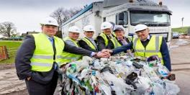
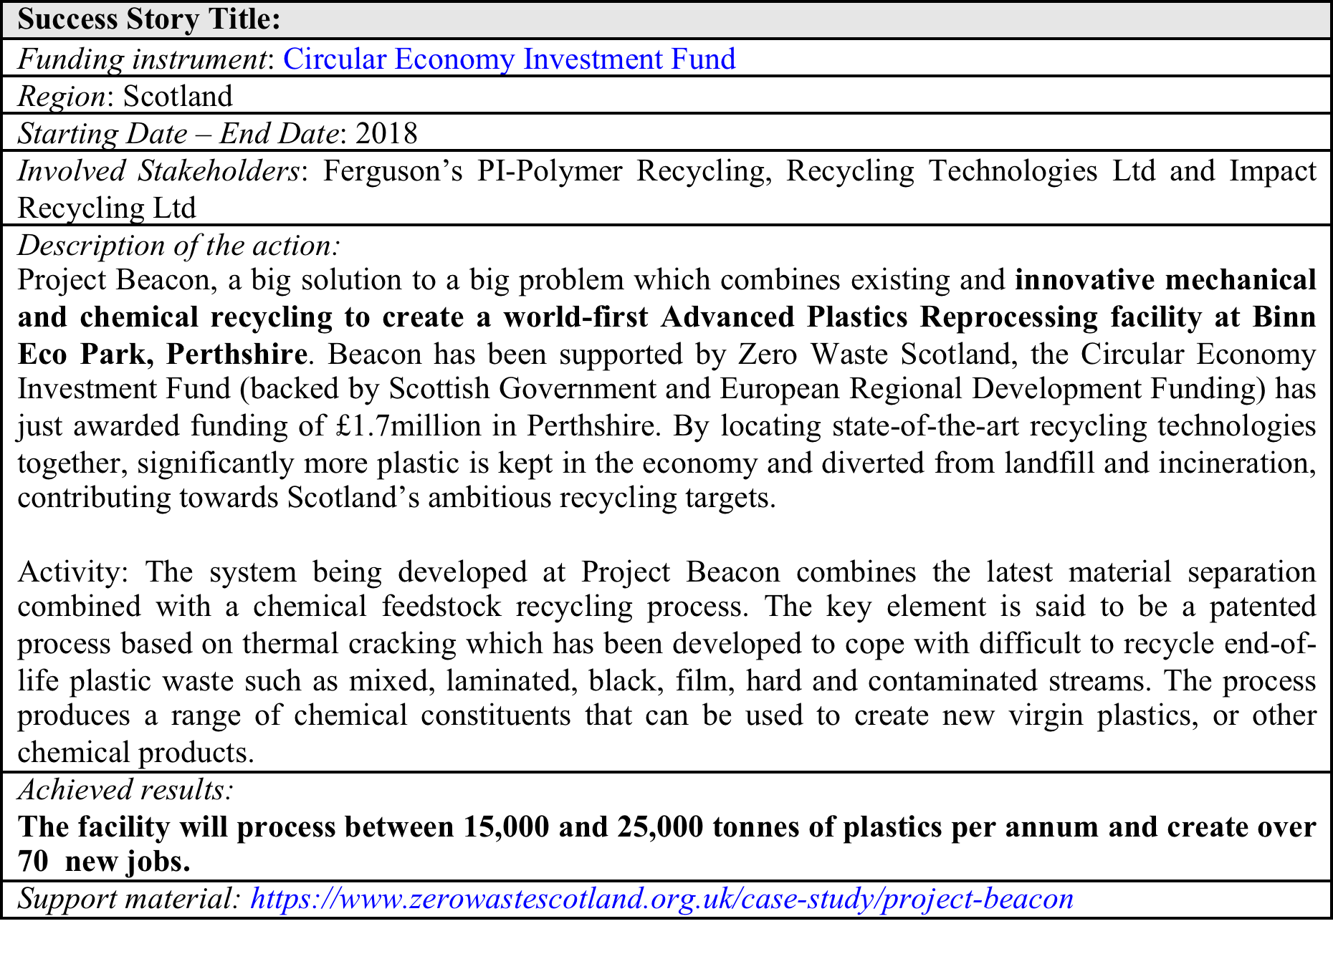
Existing funding instruments: Success stories
“By combining existing and innovative mechanical and chemical recycling technologies, project Beacon boosts the local economy and enables household and large rigid plastics to be recycled instead of incinirated”,Chief Executive Officer of Recycling Technologies.

Slide 17
Matching local emerging ideas, and cross-regional value chains with instruments
Match the Circular Economy emerging and the cross-regional value-chains towards the existing instruments, at regional and European levels.
Identify the gaps existing among investment instruments and promising Circular Economy Initiatives.
 | Investment Instrument type 1 | Investment Instrument type 2
CE Initiative 1 | X
CE Initiative 2 |  | X
CE Initiative 3 | X | X
CE Initiative 4
GAP
Identify recommendations for the definition of specific regional and multi regional measures, to be applied in support of Circular Economy initiatives.

Slide 18
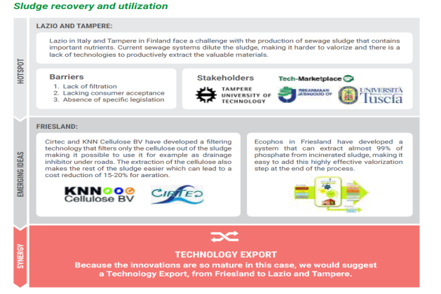
Matching local emerging ideas, and cross-regional value chains with instruments
TRL 6-7

Slide 19
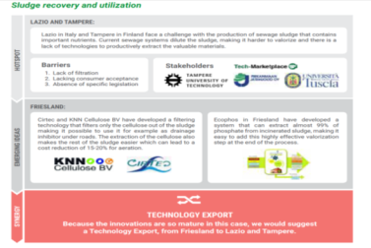
Matching local emerging ideas, and cross-regional value chains with instruments
Lazio - Circular Economy and Energy fund: Instrument targeted to SMEs providing subsidies requiring co-financing, with a funding rate between 10%-80%, at TRL 6-7, on the ROP ERDF- 2014-2020 fund, with a funding mix 50% EU, 35% national, 15% regional.
Fryslan- Circulair Economy Call Fryslân: instrument targeted to SMEs providing subsidies requiring co-financing, with a funding rate of maximum 40%, at TRL 6-7, on regional funds.

Slide 20
Considerations and recommendations
Although ”Existing financial Instruments” at regional level are usually applied in isolation, even if they could be partially used to support cross-regional initiatives, there exist recently developed instruments favouring a cross-regional cooperation (e.g. Fund of funds).
In general, cross-regional cooperation is not reflected in the evaluation of projects.
The transfer of technologies and solutions from one region to another, among sectors, is usually not supported by specific instruments.
The “Seal of Excellence” approach is currently only applied only to the SME Instrument.
Only few instruments support the development of innovation infrastructures through ERDF to de-risk by demonstration future industrial investments in circular economy.
The establishment of a ERA-NET like fund for circular economy would support the development of focused projects originated by the identified SCREEN synergies.
A cross regional open innovation initiative may be useful to promote the systematic identification of inter-regional actions, extending the SCREEN methodology beyond the project life.

Slide 21
SCREEN Methodology: From local to cross-regional value-chains
Regional data gathering
Initial data driven analysis
Local Workshops
Extended analysis
Value chain synthesis
CE measures
Synergies / emerging ideas synthesis
Actions/ projects
Funding instruments
Identification of gaps
New instrument needs
Policy Lab

Slide 22
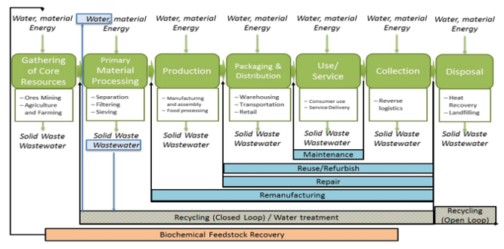
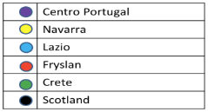
Data Driven Analysis
Starting from the tool inputs a data-driven analysis of the potential cross-regional value-chains (sector-driven, material-driven) has been carried out.
Food and beverage value-chain.

Slide 23
SCREEN Cross-regional value chains
The most relevant value-chains have been identified and analyzed:
Material-driven value-chains
Agriculture
(Smart) Packaging
Water and wastewater
Biobased materials & biotechnology
Manufacturing & de-manufacturing
(Bio)waste management
Construction/Build Environment
Business driven sectorial value-chains
Electrical and Electronic Equipment
Energy
Paper and forest-based industry
Textile
Transport and mobility
Food and beverage

Slide 24
Reference Framework: Value-Chain oriented approach
Water, material
Energy
Water, material
Energy
Water, material
Energy
Water, material
Energy
Water, material
Energy
Water, material
Energy
Gathering of Core Resources
Primary Material Processing
Production
Packaging & Distribution
Use/
Service/ Collection
Disposal
Ores Mining
Agriculture and Farming
Separation
Filtering
Sieving
Manufacturing and assembly
Food processing
Warehousing
Labelling
Transportation
Consumer usage
Reverse Logistics
Heat Recovery
Landfilling
Solid Waste
Wastewater
Solid Waste
Wastewater
Solid Waste
Wastewater
Solid Waste
Wastewater
Solid Waste
Wastewater
Solid Waste
Wastewater
Maintenance
Reuse/Refurbish
Repair
Remanufacturing
Recycle (Closed Loop)
Recycle
(Open Loop)
Biochemical Feedstock Recovery
  Glossary: A definition for the different circular economy options has been elaborated (relation to existing standards and references).

Slide 25
Methodology for Regional Cooperation
Marcello Colledani - AFIL, Lombardy Region cluster on Intelligent Factory

Slide 26







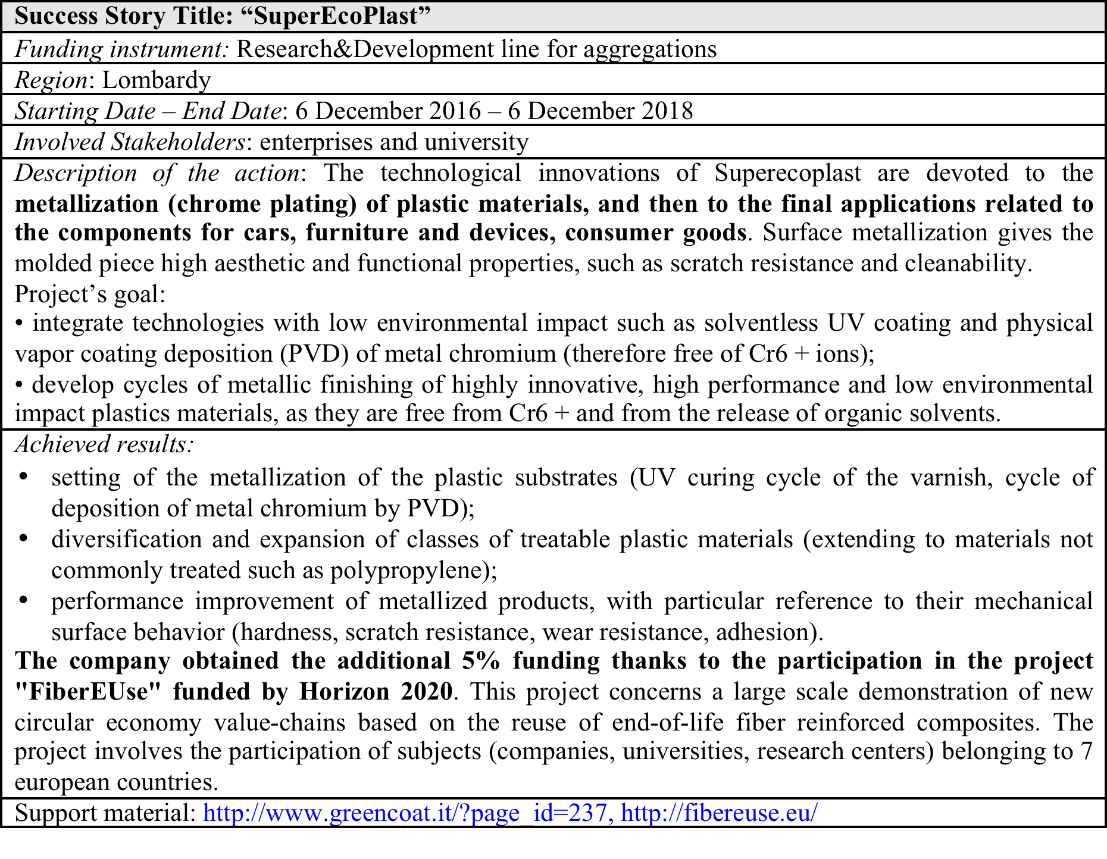
Existing funding instruments: Success stories

Slide 27
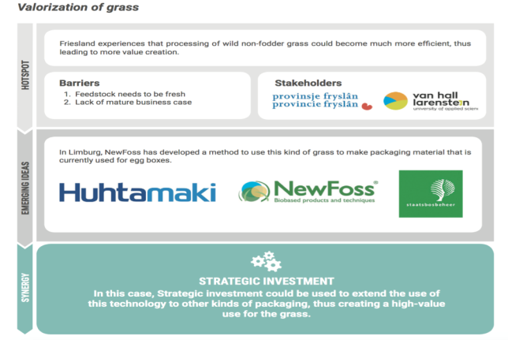
Matching local emerging ideas, and cross-regional value chains with instruments
TRL 6-7

Slide 28

Matching local emerging ideas, and cross-regional value chains with instruments
Limburg- Energy fund: Instrument targeted to industry providing loans and subsidies requiring co-financing, at TRL 6-7, using a mix or Regional and EIB funds, focused on nergy savings and circular economy.
Fryslan- Circulair Economy Call Fryslân: instrument targeted to SMEs providing subsidies requiring co-financing, with a funding rate of maximum 40%, at TRL 6-7, on regional funds.

Slide 29
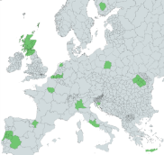

SCREEN - Identified barriers and recommendations
Bart Volkers

Slide 30

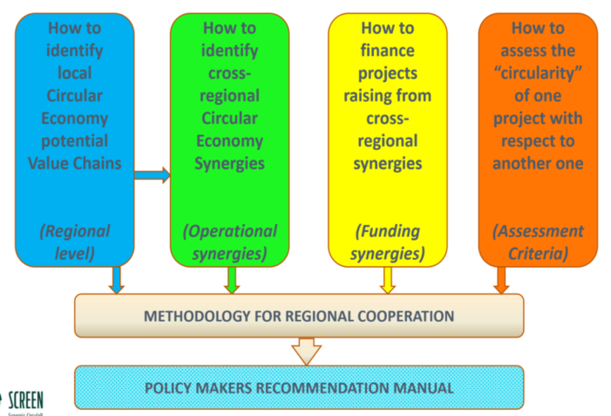

Slide 31
Policy Lab
Workshops
Questionnaire
Evaluation of Tool implementation

Slide 32
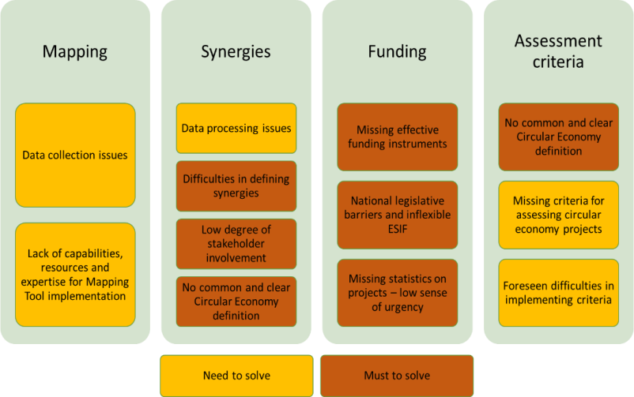
Methodology for regional cooperation – presentation Marcello Colledani, AFIL/Lombardy Region

Slide 33
Empowering Regions
Data collection & analyses
Optimalisation of Tools
Applying, evaluation and improving SCREEN tools
Policy Support & Development
Common and clear definition
Strategic Circular Transition Agenda & Action Plans
Policy Lab
Funding synergies
(Methodology Regional cooperation/Fund of Funds)
Identifying cross-regional synergies and R&I gaps
Capacity building - training
Clustering activities
Promotion & awareness raising
Stakeholder involvement – training/workshops/value chain mapping/etc.
Homogenizing statistical data
SCREEN Policy Lab: results and future steps – Carlo Polidori
Methodology for regional cooperation – presentation Marcello Colledani, AFIL/Lombardy Region
Continuation of SCREEN Network – Operational Plan
(presentation Johanna Alakerttula, Council of Tampere Region)

Slide 34
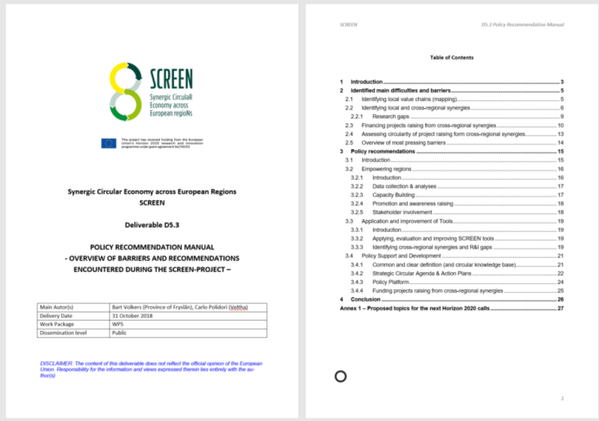
http://www.screen-lab.eu/deliverables.html
Questions/suggestions/
remarks:
b.volkers@wateralliance.nl

Slide 35


D5.2 Future steps for SCREEN network
Johanna Alakerttula, Nillo Halonen

Slide 36

SCHEME TOWARDS SCREEN NETWORK
SCREEN project consortium is taking its first steps for becoming a network after the project ends.
To support this, we are creating an action plan for the future steps to continue work.
Motivation and Goals
Starting point for the SCREEN network
Operational synergies
Synergy grids on common themes
Funding synergies
Memorandum of Understanding
Action plan
Collaboration platform
Mechanisms for network development as an open innovation platform
Recommended actions for the SCREEN network
Importance of circular economy
Importance of cross-regional synergies
Potential operational synergies
Entrepreneurial way of testing funding synergies
Assessment criteria
Identified potential in the SCREEN network
Future steps for the network
Continuous development

Slide 37
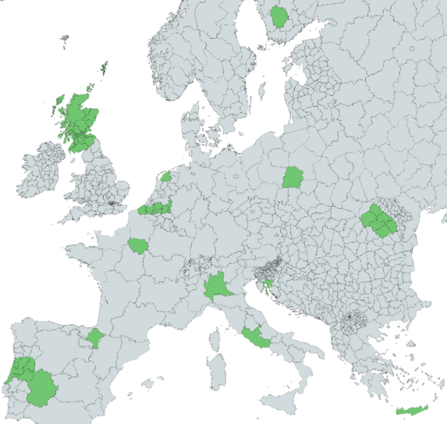
STARTING POINT FOR SCREEN NETWORK
SCREEN networks motivation comes from its ability to connect technologically advanced regions with runner ups providing a possibility for regions and their local stakeholders to increase their innovation capabilities regardless of their starting point.
Common circular economy goals are important both for the regional smart specialisations and for finding common opportunities
Cross-regional synergies, both innovation synergies and policy synergies are important fuel for the network. The SCREEN methodology enables focus in finding fit between cross-regional capabilities.
17 European Regions
12 European Countries
+30 International and local workshops
6 Policy lab meetings
+20 circular economy value chains
+200 Identified emerging ideas
+20 Potential operational synergies
+100 cross-regional funding synergies
9 Signed Memorandum of understandings, Letter of Intents
Notes:
Emergent topic → systemic challenges

Slide 38
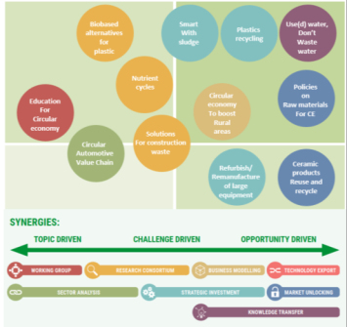
FROM CROSS-REGIONAL OPPORTUNITIES TO OPERATIONAL SYNERGIES
During the SCREEN project much of work has been done to identify synergies between regions. Now we are preparing future actions to realise operational synergies into initiatives.
We have used regional baseline analysis, local workshops, thematic working groups and international workshops to structure operational synergies
We have identified +20 different types of potential operational synergies to take forward in SCREEN network

Slide 39
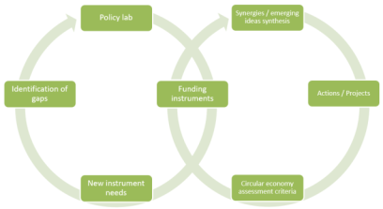
FUNDING SYNERGIES FOR MORE EFFICIENT USE OF FUNDING INSTRUMENTS
Work has been done towards finding solutions for more effective use of different funding instruments to support both, cross-regional cooperation and circular economy initiatives.
Currently work is done in finding pilot action for testing funding synergies.
Regions are contacting their national contact points to find project application that have been well ranked above treshold but not financed.
Waiting for the European Commission to update the Article 70, that is designed to support the use of funds in cross-regional initiatives.

Slide 40
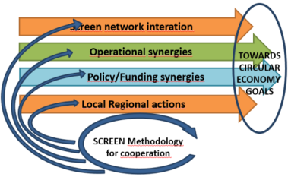
ACTION PLAN TO FACILITATE CIRCULAR ECONOMY DEVELOPMENT
Pilot action for funding synergies, Commitment of stakeholders
Policy lab as a living lab and meeting point for regions, countries and EU, Funding instruments supporting cross-regional collaboration
Implementation of SCREEN methodology, Common initiatives, direct connections to regional stakeholders
Open innovation platform facilitating emergent and systemic challenge of circular economy
Action plan is created to continue work based on the results of SCREEN project
As a short term goal it is essential to find commitment and apply SCREEN tools and results in strategic work.
As a longer term goal is to formalize Policy lab as a living lab for policy development between regions and European Commission.
As a cross-regional network it is essential to work in parallel streams of action both on cross-regional and local levels. This enables to bring systematically regional stakeholders to the same table.

Slide 41
COLLABORATION PLATFORM TO FACILITATE NETWORK COOPERATION
Goal is to form a Functional collaboration platform for regions to support their development towards circular economy and continue to use the results of SCREEN project.
The collaboration platform is under a planning phase and we are considering next steps to realise the goal
The design principles for the platform development:
  Synergic Circular Economy Across European Regions is the driving force in the SCREEN network
  Network effect – partners creating value for each other and making platform attractive to each other
  Core building blocks – Community, Space and Activities and connections between
SCREEN NETWORK
POLICY LAB,
CROSS-REGIONAL INTERACTION
OPERATIONAL AND FUNDING SYNERGIES
INITIATIVES SUPPORTING CIRCULAR ECONOMY
Notes:
Now,
However, only the network effect, in which the platform’s
users – one or more user groups – create value for each
other and make the platform attractive to each other, turns
the activities into a functional platform and spreads the cul-
ture of working together. The community, space and activities
can be facilitated in many different ways to support this joint
value creation process

Slide 42



THANK YOU.
Johanna Alakerttula
Council of Tampere region,
Puh. 044 422 2249
johanna.alakerttula@pirkanmaa.fi
Nillo Halonen
Tampere University of Technology
tel. +358 50 447 8378
email nillo.halonen@tut.fi
Notes:
Lisätty SCREEN-logo

Slide 43
Carlo Polidori
SCREEN Project Manager

Slide 44

The four steps of the SCREEN project
How to identify local Circular Economy potential and existing Value Chains
(Regional level)
How to identify cross-regional
Circular Economy Synergies
(Operational synergies)
How to finance projects raising from cross-regional synergies
(Funding synergies)
How to assess the “circularity” of one project with respect to another one
(Assessment Criteria)
+
Methodology for Regional Cooperation
Policy Makers Recommendation Manual

Slide 45
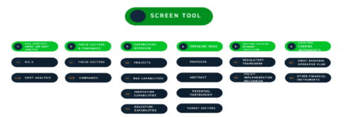
Mapping tool

Slide 46

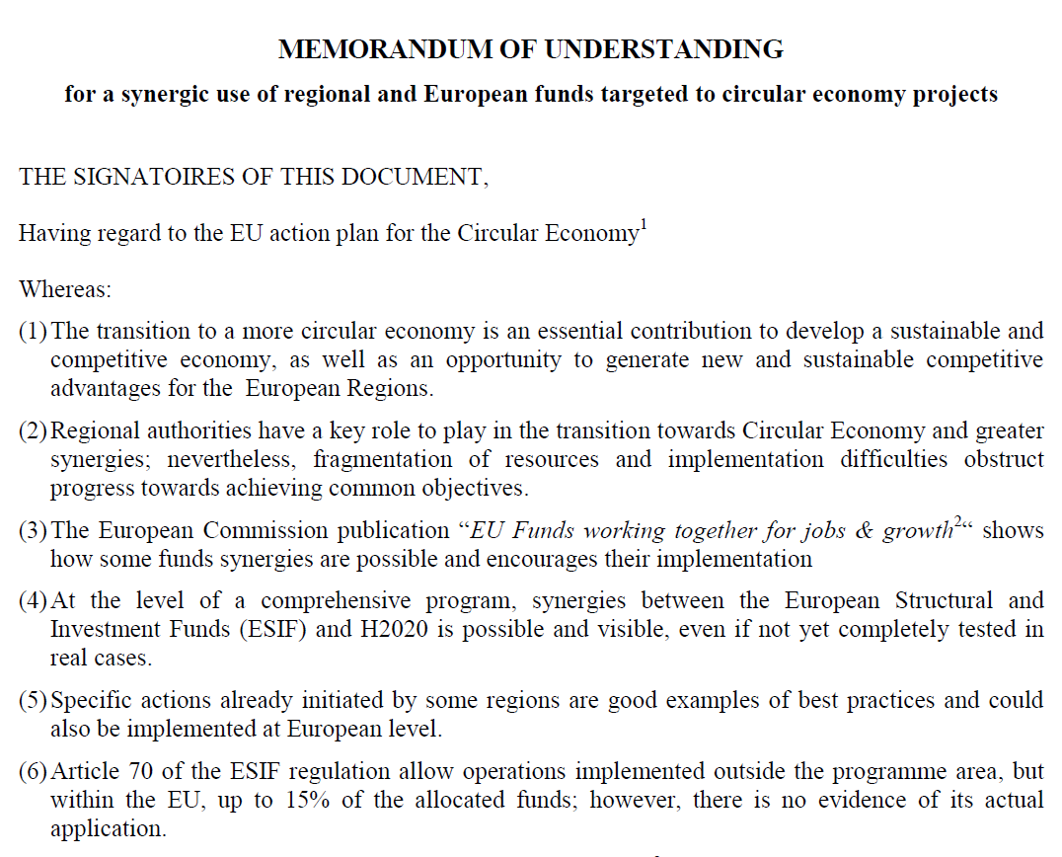
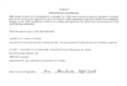
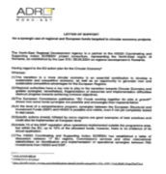
Laboratory on Policies
OPEN to all European regions!!
Text, explanatory notes and already signed documents available at:
http://www.screen-lab.eu/Step3.html
Notes:
Result of a series of discussions within the Policy Lab
Designed to be a “Multi-partner Seal of Excellence” allowing actual financing
First signatures already achieved in the first quarter of 2018, further ones are coming
Open to all EU regions

Slide 47
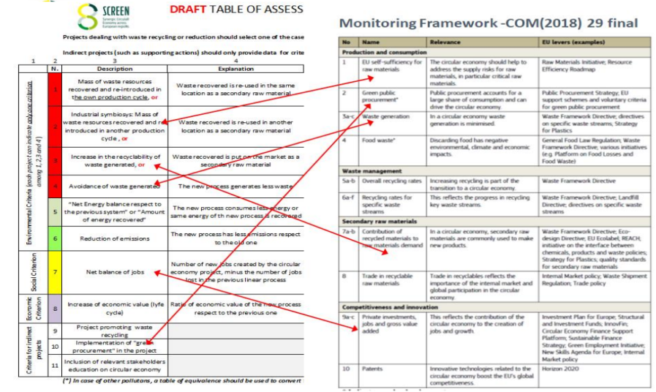
Assessment criteria for circular economy projects (to be added to the usual ones in case of C.E. projects)

