Slide 1
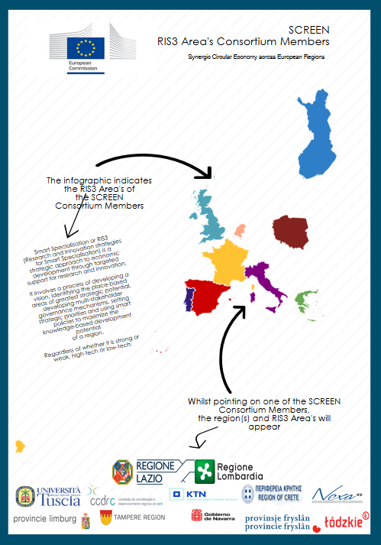
WP3: Identification synergies & complementaries
Identifying synergies & complementaries among the participating regions in order to define measures to be dicussed in workshop 2
WP2: Potential synergies -> WP3: measures for new strategic value chains
Strong support of WP4.1 & 4.2 -> workshops
Synergies & complementaries for new crossregional strategic value chains:
New Value Chains (functional and/or collaborative)
Financial/instrumental: funding
Barriers/shortcuts & legislation

Slide 2
Task 3.1: Identification of synergies and complementarities among regions
In this task, based on the grid potential synergies developed for each region by the previous task 2.3, untapped opportunities for new circular economy businesses will be highlighted, considering both traditional process industry and manufacturing sectors as well as emerging sectors, such as those in the bio-economy industry.
Furthermore, the SCREEN consortium will develop a “circularity” scoring and assessment framework, shared among the participating regions.
Based on these “circularity” evaluation criteria, a subset of strategic sectors will be selected and the related representatives (coming from different regions) will be invited to participate at the Workshop 2 for the discussion of barriers and possible shortcuts

Slide 3
Overview WP 2 & 3
Tasks | Taskleader | Name
2.1 | Lombardia | Definition Common Criteria
2.2 | Unitus | Local analysis in each region
2.3 | Fryslân | Identifcation local value chains
Tasks | Taskleader | Name
3.1 | Fryslân | Identification of synergies & complementaries
3.2 | Lazio | Policy Lab
3.3 | Unitus | 1st, 2nd, 3rd level classification
3.4 | Lombardia | Definition specific measures
Tasks | Taskleader | Name
4.1 | Lombardia | Cross regional analysis & matching criteria
4.2 | CENTRO | Normatice barriers & shortcuts
Tasks | Taskleader | Name
5.3 | Fryslan | Final version of procedure

Slide 4
WP2
T3.1 & Workshop 1
T. 3.3 Classification
Local workshop
Matchingcriteria
Opportunity size
Smart Spec.
Value chains
Capabilities
Potential synergies
Synergies & complementaries strategic new vale chains
Sector growth
Compe-tences
Input-output
Proces
TRL
T3.4 Policy measures &
workshop 2
T3.2 Policy Lab
Local workshop

Slide 5
Planning
Grid for potential synergies
Report on Synergies
Policy Lab report
 | Nov | Dec | Jan | Feb | Mrch | April | May | June | July | Aug | Sept | Okt | Nov | Dec | Jan | Feb
2.3
3.1 |  |  |  |  |  |  |  | W1
3.2
3.3
3.4 |  |  |  |  |  |  |  |  |  |  |  |  |  |  | W2
Three-level classification methodology
Multi regional portfolio investment instruments & specific measure

Slide 6
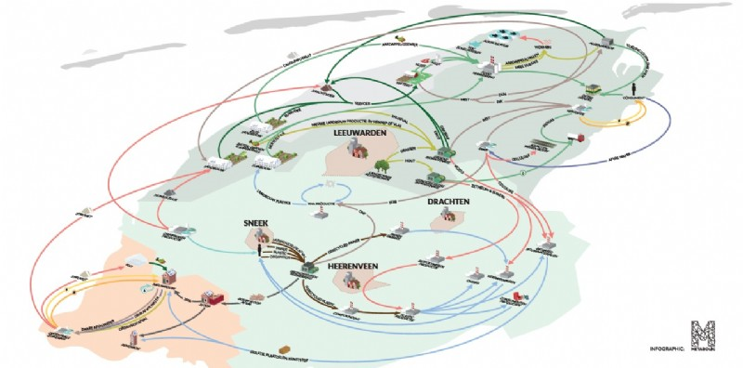
Projectplan: Grid for potential synergies
Requirements & criteria:
Smart Specialization – Fixed
Regional capabilities – Fixed
Matching criteria – capabilities & emerging ideas

Slide 7
Some of the emerging ideas
Lombardy | Navarra | Crete | Scotland | Fryslân | Tampere
Nylon socks recycling | Renawable energies | Reduce water losses, optimal water management services and infrastructure | Mixed plastic waste depolymerisation | Resource recovery from wastewater and sludge (nutrients, cellulose, energy, etc.) | Woodbased bio economy materials
De- and remanufacturing metal sheets form cars | Agrofood industries | Management systems for urban or industrial wastewater |  | Washing water from waste and metals | Nutrient cycles waste (water)
Cellulose based packaging | Functional printing | Resource recovery from wastewater |  | Waterabstraction at dairy farm | Biogas and biofuels from wood and waste (water)
Surface finishing for drying process | Automotion | Circular building materials |  | Blue Energy | Smart digital platform
Recylcing composites in manufacturing industry | Agriculture | Energy saving in buildings |  | (Warm) water in circular buildings | Fibre reinforcement
Smart recycling systems of the future |  | Wastewater treatment at wineries |  | Textile wastewater recovery | Rubbers
Recylcing battery systems for hybrid and electrical cars |  | Vegetable waste from greenhouses and olives |  | Water saving & reuse in agrofood | Polymers & microsized particles in sea
 |  | Whey cheese as animal feed |  | ++ | ++++++
 |  | +++++

Slide 8
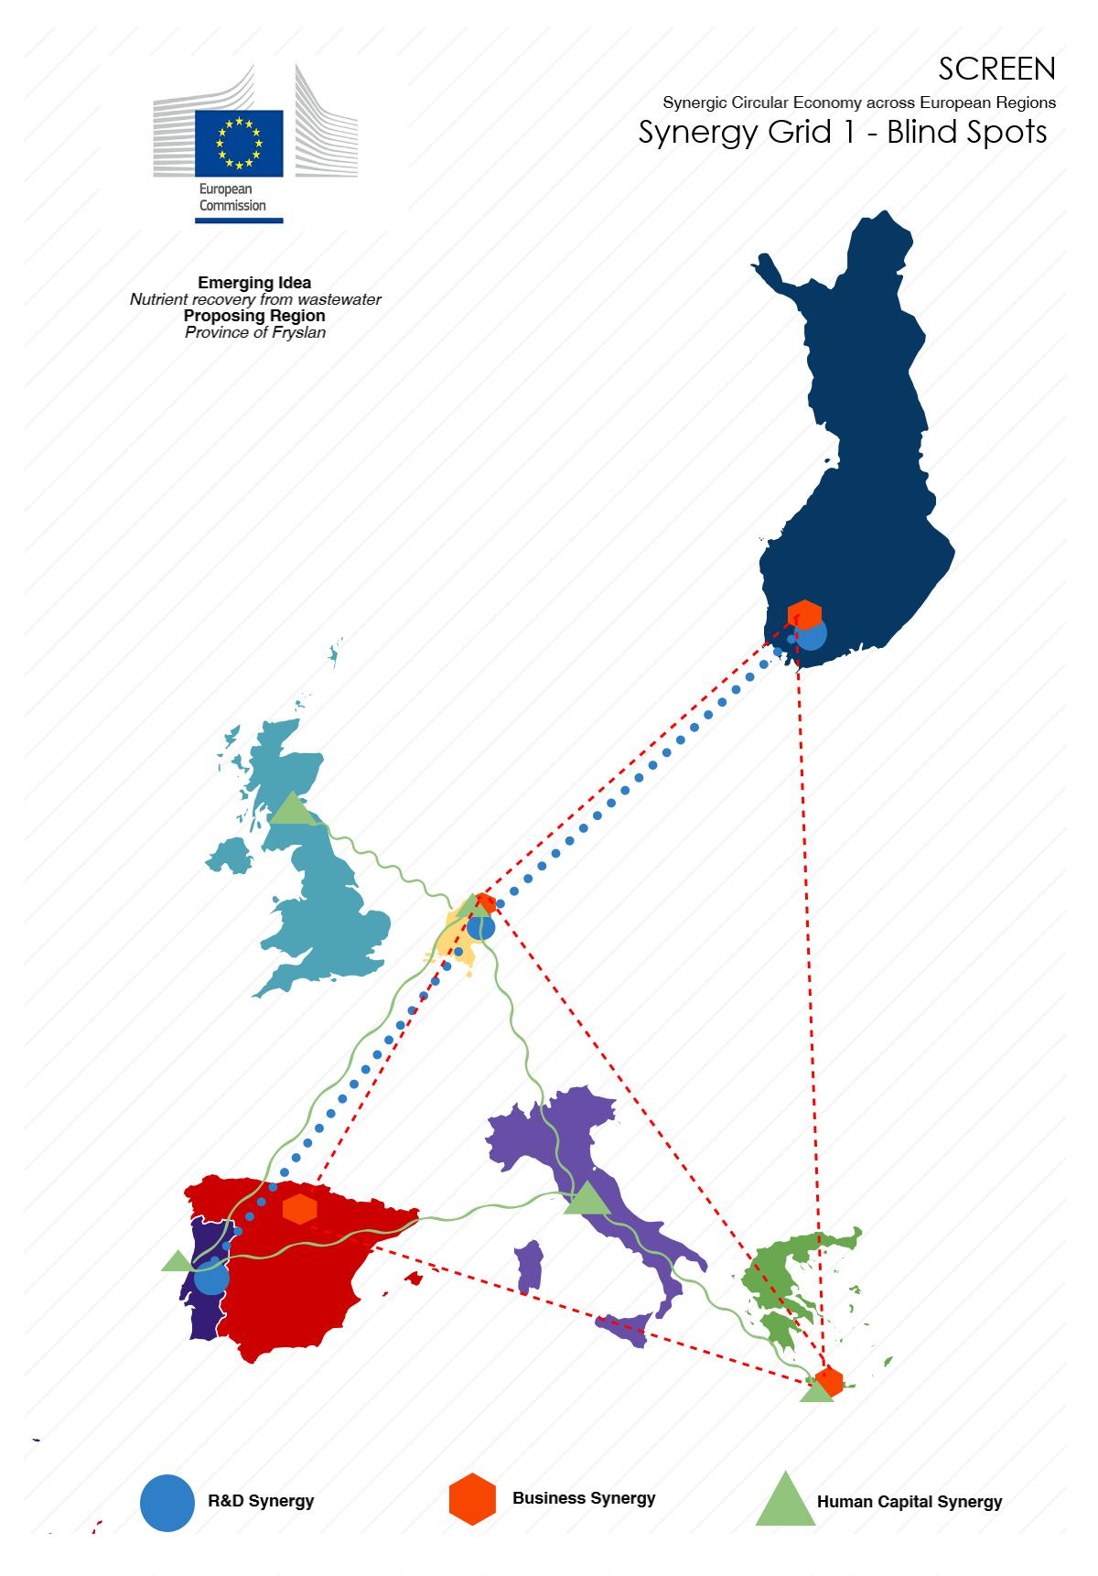
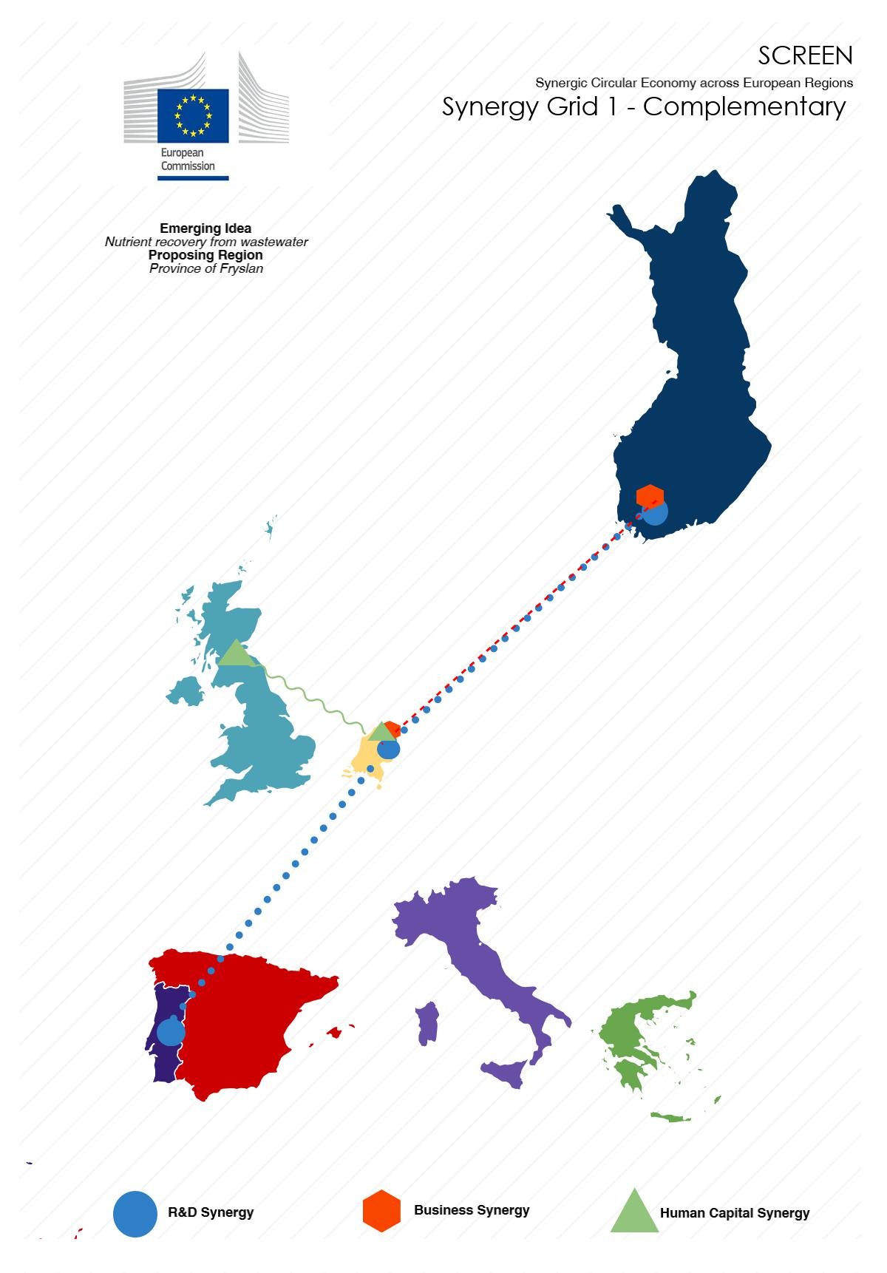
Notes:
Synergy grid 1 -> screen1 synergy grid 2 → screen2

Slide 9
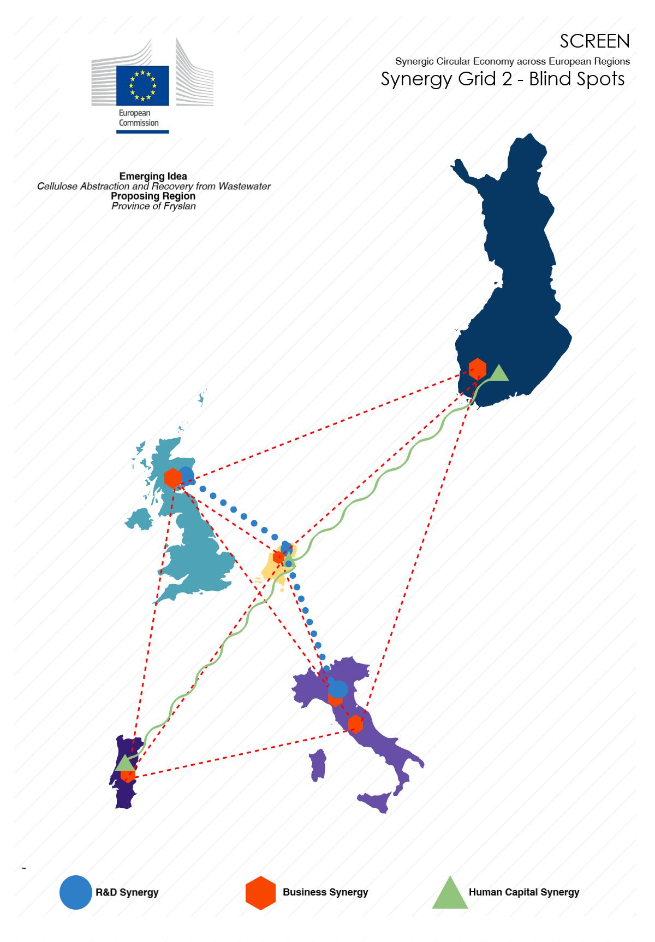


Slide 10
Planning WP2.3
Methodology webinar: Excel & Grid mapping (Fryslân)
 | 11 | 12 | 13 | 14 | 15 | 16 | 17 | 18 | 19 | 20 | 21 | 22 | 23 | 24 | 25 | 26
Excell-Tool
Complete (specific and practical) (all) | X
Data-check (all) | X | X
Overview (wp2.2) AND synergy mapping (Fryslân) |  |  | X
Follow-up interactive work
Minutes/synergies (Fryslân) | X
Format synergies (Fryslân) |  | X
Potential synergies follow-up (owners) |  |  | X | X | X | X
Table voting system – give 10 (all) | X
Overview: matching and/or & appointing existing/new owners (Fryslân) |  | X | X
Follow-up synergies voting system |  |  | X | X | X | X
Grid Development
Sharing grids so far (owners) (call/meeting) |  |  |  |  |  |  | X
Draft grids (owners) |  |  |  |  |  |  |  | X | X | X
Review en reporting (Fryslan) |  |  |  |  |  |  |  |  |  |  | X | X | X
Final Grid
Presentation Milano |  |  |  |  |  |  |  |  |  |  |  |  |  |  |  | X
Finalizing (+ 1 wk)

Slide 11
WP3: Identification synergies & complementaries
Identifying synergies & complementaries among the participating regions in order to define measures to be dicussed in workshop 2
WP2: Potential synergies -> WP3: measures for new strategic value chains
Strong support of WP4.1 & 4.2 -> workshops
Synergies & complementaries for new crossregional strategic value chains:
New Value Chains (functional and/or collaborative)
Financial/instrumental: funding
Barriers/shortcuts & legislation

Slide 12
Task 3.1: Identification of synergies and complementarities among regions
In this task, based on the grid potential synergies developed for each region by the previous task 2.3, untapped opportunities for new circular economy businesses will be highlighted, considering both traditional process industry and manufacturing sectors as well as emerging sectors, such as those in the bio-economy industry.
Furthermore, the SCREEN consortium will develop a “circularity” scoring and assessment framework, shared among the participating regions.
Based on these “circularity” evaluation criteria, a subset of strategic sectors will be selected and the related representatives (coming from different regions) will be invited to participate at the Workshop 2 for the discussion of barriers and possible shortcuts

Slide 13
WP2
T3.1 & Workshop 1
T. 3.3 Classification
Local workshop
Matchingcriteria
Opportunity size
Smart Spec.
Value chains
Capabilities
Potential synergies
Synergies & complementaries strategic new vale chains
Sector growth
Compe-tences
Input-output
Proces
TRL
T3.4 Policy measures &
workshop 2
T3.2 Policy Lab
Local workshop

Slide 14
WP3.1 Identification of synergies & complementaries
Compe-tences
Input-output
Proces
Cross input-output analysis
Cross competence analysis
Cross process analysis

Slide 15
Next steps
Fryslân as taskleader wp3.1
Owners of value chains
Q2: Development of guideline:
  Research
  Stakeholder analysis
  Workshop
  With help of WP3 task leaders and other consortium experts
Q2: Make example for water:
  Drinkingwater – waste water
  Processing water:
    (Agro)Food processing
    …….
Q2/3 Execute analysis ‘exercising’:
  Stakeholders
  Local analysis
  Cross-regional
Q2/3 Development of methodology:
  Functional vs collaborative (Milano)
  Clustering workshop (KTN)
Q2/3 Inter/cross-regional cooperation:
  Further detailing cross regional cooperation based on synergies
  E-mai/tel. conf/meetings
2nd international workshop (Q4 2017/Q1 2018)
Joint development: Circularity framework as results from 3.1 – 3.2 – 3.3 – 33.4

Slide 16
Notes:
Synergy grid 1 -> screen1 synergy grid 2 → screen2

Slide 17
But first:
Methodology webinar: Excel & Grid mapping (Fryslân)
 | 11 | 12 | 13 | 14 | 15 | 16 | 17 | 18 | 19 | 20 | 21 | 22 | 23 | 24 | 25 | 26
Excell-Tool
Complete (specific and practical) (all) | X
Data-check (all) | X | X
Overview (wp2.2) AND synergy mapping (Fryslân) |  |  | X
Follow-up interactive work
Minutes/synergies (Fryslân) | X
Format synergies (Fryslân) |  | X
Potential synergies follow-up (owners) |  |  | X | X | X | X
Table voting system – give 10 (all) | X
Overview: matching and/or & appointing existing/new owners (Fryslân) |  | X | X
Follow-up synergies voting system |  |  | X | X | X | X
Grid Development
Sharing grids so far (owners) (call/meeting) |  |  |  |  |  |  | X
Draft grids (owners) |  |  |  |  |  |  |  | X | X | X
Review en reporting (Fryslan) |  |  |  |  |  |  |  |  |  |  | X | X | X
Final Grid
Presentation Milano |  |  |  |  |  |  |  |  |  |  |  |  |  |  |  | X
Finalizing (+ 1 wk)

Slide 18
Notes:
Synergy grid 1 -> screen1 synergy grid 2 → screen2

