Slide 1
SCREEN
Projectmeeting
16th-17th of March 2017
Rome
Contribution Fryslân – Bart Volkers
Notes:
Logo’s van Metabolic en CEW erbij

Slide 2
Topics
Excecution Work Package 2.3
WP 2.3 Methodology and Example Synergy Grids

Slide 3
Context WP 2.3
Main objective WP2
“ to develop a methodology for the assessment of regional capabilities in the involved regions, grounding on their existing Smart Specialization Strategies.”
Objective WP2.3
“The identification of local value chains among the involved regions. This task will deliver, for each region, a grid for potential synergies with the other regions, taking into account the TRL of each identified value chain.”
Deliverables: Map for potential synergies for each region c.q. Synergy Grid

Slide 4
WP 2.3
Methodology and Concept Synergy Grids
Step 1 Data Check Mapping Tool Complete & Applicable?
Step 2 RIS3 Filter Coherent with RIS3 Platform Seville?
Step 3 Focussectors Identification and specification of focussectors?
Step 4 Remarks Regions Questions? Missing data?
Criteria Synergy Grid
RIS3/SWOT
Capabilities (R&D, Business, Human Capital)
Emerging Idea
Notes:
Derde colom: specificatie en opmerking.

Slide 5
Step 1:Data check

Slide 6
Step 1: Data remarks
RIS3: specific detailed focus areas vs. broad range of specializations
Focus sectors: specific focus sectors vs all focus sectors
Capabilities: what are the capabilities specific for RIS3/Sectors?
For example: Specific specialization vs amount of universities?
Correct interpretation of data

Slide 7
Step 2: RIS
Watertechnology
Bio-economy
Green Economy
Environmental
Sustainability
Renewable Energy
Energy
Marine Energy
Agrofood
Life Sciences
Agroculture
Food & Beverages
Forestry
Sea
Natural resources
Anufacturing
Materials
Digital Creative Industries
Aerospace
ICT
Tourism
Culture & Tourism
Cultural Heritage

Slide 8
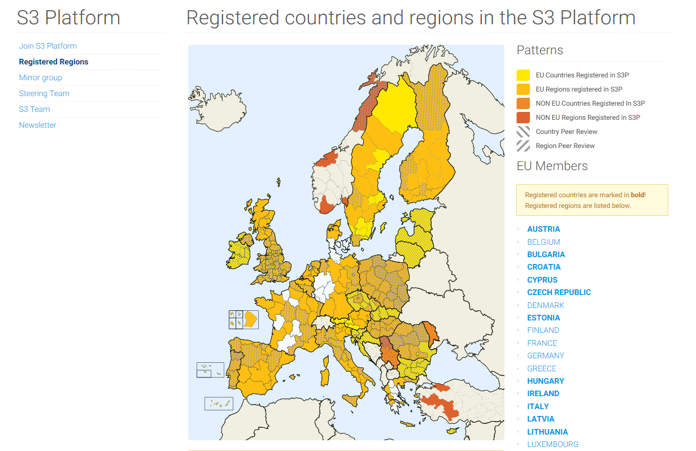
Check S3-Platform

Slide 9
Step 3 focussectors

Slide 10
Recommendation towards WP2.3 & 3.1
Be Specific and smart
BE SPECIFIC AND SMART:
  MAX 2 SMART SPECIALIZATION
  MAX 3 FOCUS SECTORS
LATER: DEPENDING ON IDENTIFIED SYNERGIES OTHER ALIGNING SPECIALIZATIONS AND FOCUS SECTORS MAY BE ADDED
CHOICE FOR SMART SPECIALIZATIONS MAY BE BASED ON:
  REGIONAL COMMITMENT AND ACTUAL POLICY
  PROBABLE FUTURE INVESTMENTS/FUNDING
  STRONG OR NEEDED CAPABILITIES
  WHICH SPECIALIZATIONS GAIN THE MOST WITH SCREEN
CHOICE FOR FOCUS SECTORS MAY BE BASED ON:
  STAKEHOLDER COMMITMENT
  ACCESSABILITY FOR WORKSHOPS/INPUT
  NEED FOR SOLUTIONS OR NEW VALUE CHAINS
  (POSSIBLE) ALIGNMENT WITH RIS3
  WHICH SECTORS GAIN THE MOST WITH SCREEN
Example: Fryslân
Example: Navarra

Slide 11
Recommendation towards WP2.3 & 3.1
From Data to interaction
INTERACTION:
MAKE DATA COMPREHENSIVE – OVERVIEW AND FIRST GRIDS
GUT FEELING:
  TABLE VOTING SYSTEM - GIVE 10 SYNERGY MAPPING
  INTERACTIVE WORK TODAY
OWNERSHIP:
ONE SYNERGY SHOULD BE ‘CARRIED’ BY AT LEAST 2 REGIONS
CARRIERS SHOULD FEEL COMFORTABLE CHECKING AND/OR DEFENDING THEIR SYNERGIES WITH THEIR STAKEHOLDERS (INTERVIEWS/WORKSHOP(S))
CARRIES SHOULD ASK OTHER REGIONS FOR INPUT AND FOR CREATING A SYNERGY GRID

Slide 12
Concept Synergy Grid
The realisation of a Synergy Grid?
RIS3 & Sectors (part of SWOT) vs. Capabilities Region – emerging ideas
RIS3 & sectors: provide focus on i.e. strenghts, opportunity's, sectors
Capabilities region
R&D-infrastructure - Business-infrastructure - Human Capital Infrastructure
Emerging ideas are guiding for synergies
- Scale 1-3 → Determination of Region’s Capability in Excel-Synergy Grid
Visualisation Excel-Synergy Grid in Infographic

Slide 13
Recommendation: use emerging ideas
Lombardy | Navarra | Crete | Scotland | Fryslân | Tampere
Nylon socks recycling | Clustering on Renawable energies | reduce water losses, optimal water management services and infrastructure | Mixed plastic waste depolymerisation | Resource recovery from wastewater and sludge (nutrients, cellulose, energy, etc.) | Woodbased bio economy materials
De- and remanufacturing metal sheets form cars | Clustering on Agrofood industries | Management systems for urban or industrial wastewater |  | Washing water from waste and metals | Nutrient cycles waste (water)
Cellulose based packaging | Clustering om Functional print | Resource recovery from wastewater |  | Waterabstraction at dairy farm | Biogas and biofuels from wood and waste (water)
Surface finishing for drying process | Clustering and knowledge building on utomotion | Circular building materials |  | Blue Energy | Smart digital platform
Recylcing composites in manufacturing industry | Clustering on Agriculture | Energy saving in buildings |  | (Warm) water in circular buildings | Fibre reinforcement
Smart recycling systems of the future |  | Wastewater treatment at wineries |  | Textile wastewater recovery | Rubbers
Recylcing battery systems for hybrid and electrical cars |  | Vegetable waste from greenhouses and olives |  | Water saving & reuse in agrofood | Polymers & microsized particles in sea
 |  | Whey cheese as animal feed |  |  | ++++++
 |  | +++++

Slide 14
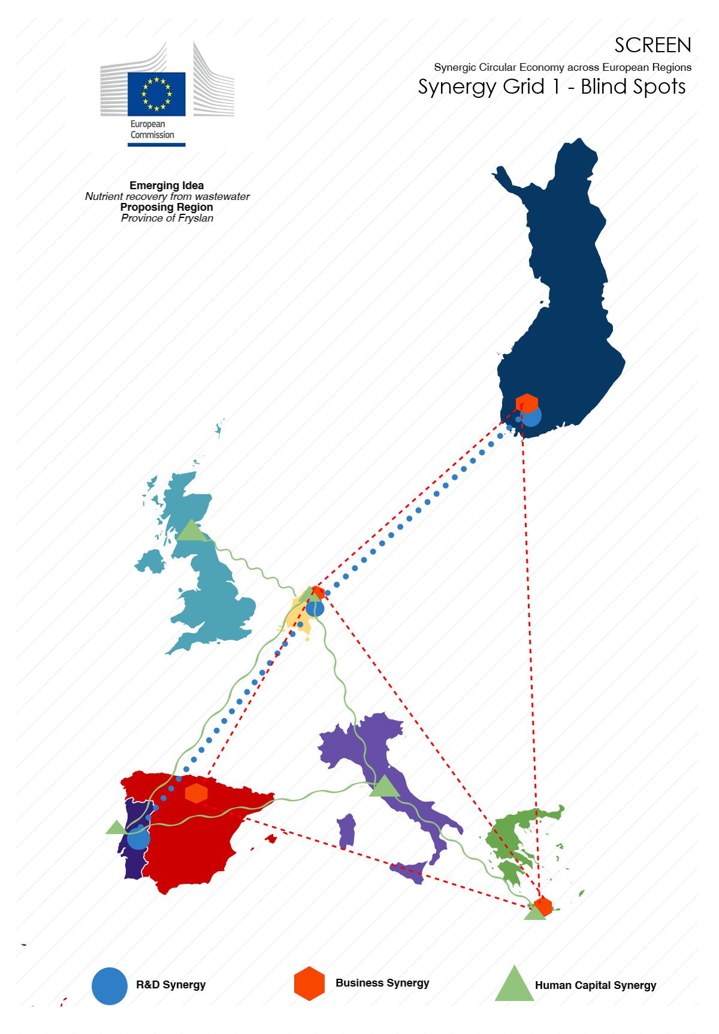
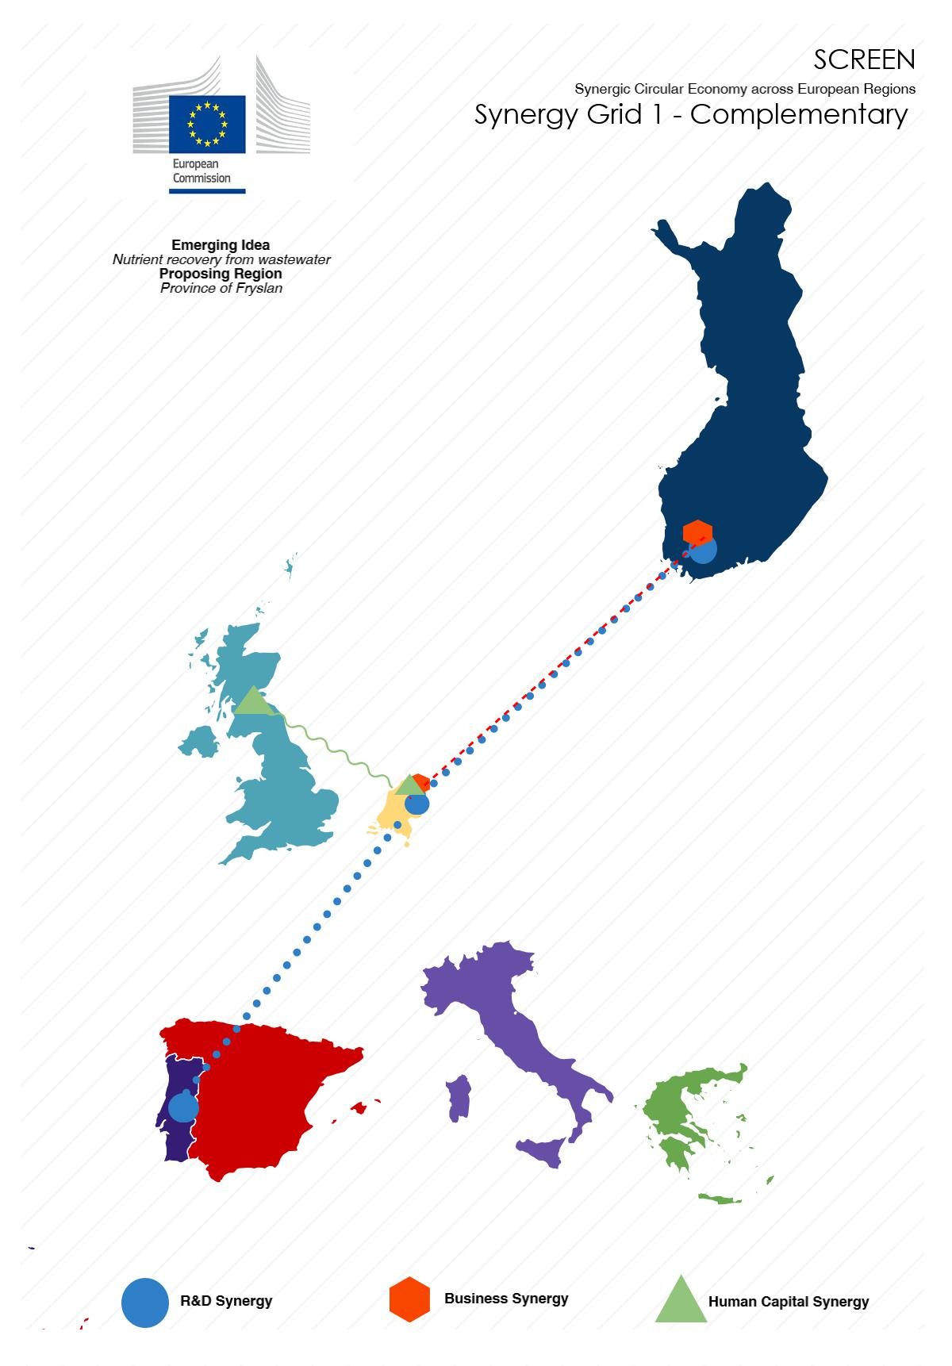
Notes:
Synergy grid 1 -> screen1 synergy grid 2 → screen2

Slide 15
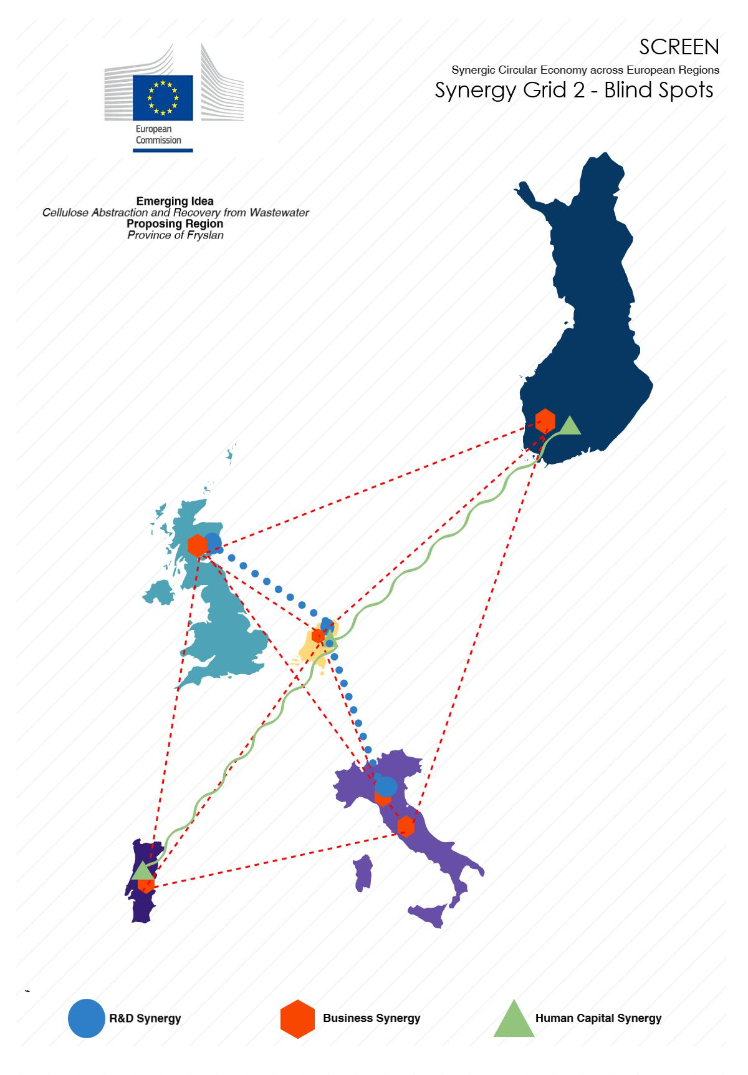


Slide 16
Planning WP2.3
Methodology webinar: Excel & Grid mapping (Fryslân)
 | 11 | 12 | 13 | 14 | 15 | 16 | 17 | 18 | 19 | 20 | 21 | 22 | 23 | 24 | 25 | 26
Excell-Tool
Complete (specific and practical) (all) | X
Data-check (all) | X | X
Overview (wp2.2) AND synergy mapping (Fryslân) |  |  | X
Follow-up interactive work
Minutes/synergies (Fryslân) | X
Format synergies (Fryslân) |  | X
Potential synergies follow-up (owners) |  |  | X | X | X | X
Table voting system – give 10 (all) | X
Overview: matching and/or & appointing existing/new owners (Fryslân) |  | X | X
Follow-up synergies voting system |  |  | X | X | X | X
Grid Development
Sharing grids so far (owners) (call/meeting) |  |  |  |  |  |  | X
Draft grids (owners) |  |  |  |  |  |  |  | X | X | X
Review en reporting (Fryslan) |  |  |  |  |  |  |  |  |  |  | X | X | X
Final Grid
Presentation Milano |  |  |  |  |  |  |  |  |  |  |  |  |  |  |  | X
Finalizing (+ 1 wk)

Slide 17
Interactive work
COFFEE-BREAK - START NOT LATER THAN 17.15u:
Groups of 6 to 10 persons from different regions (we will have 2 or 3 groups
2-minutes-pitch:
  1) Who you are and from which region;
  2) What do you believe is your regions most important specialization for SCREEN (max 2);
  3) What do you believe is your regions most important sector for SCREEN (max 2);
  4) What synergies and potential value chains fits best with the capabilities and needs of your region (max 2);
INTERACTIVE WORK – 17.30
Top 5 synergies & value chains that align with more than one RIS3-strategy and it should fit within a regions focus sector.
Discuss the synergies & value chains and come up with the following:
  1) Two or three synergy/value chain 'owners' from different regions representing the synergy
  2) Short description or explanation of the value chain
  3) Show/describe synergy: R&D-capabilities, Business-capabilities, Human Capital/education-capabilities
18.15 'Volunteers‘-pitches
18.30 Short Follow-up & closing of interactive work (by Bart) - 5 minutes.

