Slide 1
SCREEN
Synergic CirculaR Economy across European regioNs
WP2, Task 2.1
Definition of the Common Criteria
Lombardy Region - AFIL

Slide 2
Objective of WP 2 “Cross Analysis”
Objective of the Work Package :
To develop a methodology for the assessment of regional capabilities and best practices in the involved regions, grounding on their existing Smart Specialization Strategies.
To identify specific synergies and complementarities among sectors, value chains and markets, in order to highlight and evaluate potential strategic business cases that could significantly contribute to the transition towards new circular economy business models.
Lombardia, Regione Lazio, Unitus, Gvt. Navarra, Centro, Lodzkie Region, Perifereia, NEXA, THE KTN, Limburg Region, Fryslân

Slide 3
Structure of WP 2 “Cross analysis”
Task 2.1
Lombardy
Task 2.2
Unitus
Task 2.3
Fryslân
Definition of the Common Criteria
Local analysis
in each region
Identification of local and cross-regional value chains
Define a simple information structure for the analysis of the existing regional capabilities.
Inspired by the approach adopted in the multi-regional Vanguard Pilot on “De-and Remanufacturing for Circular Economy”.
D2.3: Guidelines containing Common Criteria (M3)
Horizontal analysis.
Conducted according to the capabilities collected in the previous task.
Will produce the basis for the cross-regional identification of new value chains in the area of circular economy.
D2.2: Local Analyses (M6)
Deliver for each Region a grid of local value chains and potential synergies with the other regions.
Fryslân actually mapped the entire flow of resources from initial input, conversion to other products.
D2.3: Synergies Grid
(M8)

Slide 4
Structure of WP 2 “Cross analysis”
Task 2.1
Lombardy
Task 2.2
Unitus
Task 2.3
Fryslân
Definition of the Common Criteria
Local analysis
in each region
Identification of local and cross-regional value chains
D2.3: Guidelines containing Common Criteria (M3)
D2.2: Local Analyses (M6)
D2.3: Synergies Grid
(M8)
Workshop1: cross-regional analysis and matching criteria Lombardy (28-29 June 2017)

Slide 5
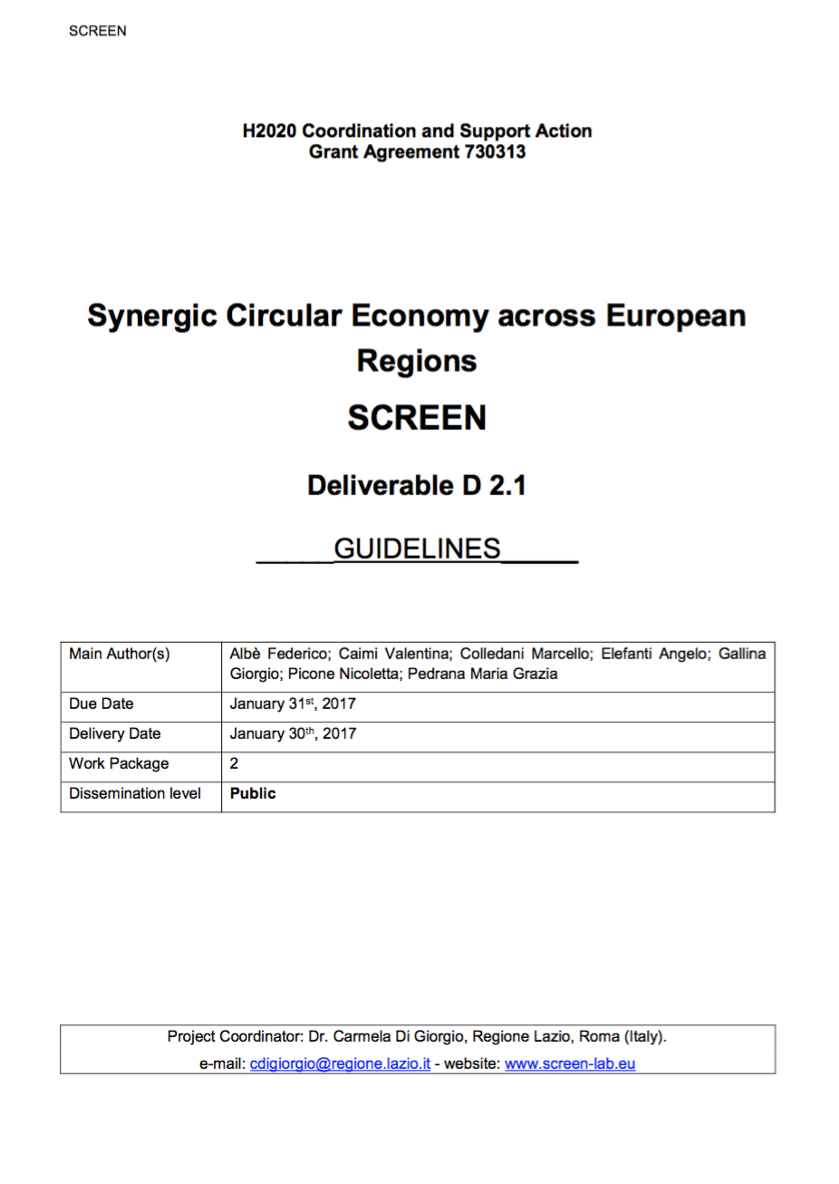
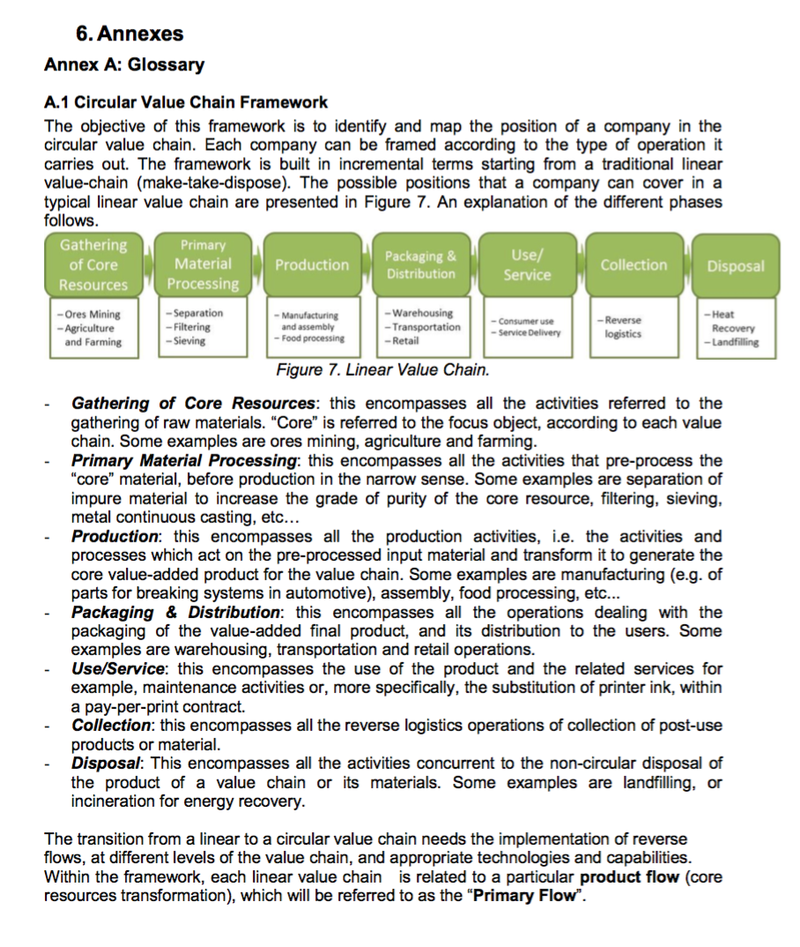
Activity 2.1 and next steps
Achieved Results: Guidelines and Excel Tool delivered on January 30th
Ongoing activities :
Activity 2.2 | Unitus: Local Analysis in each region
Activity 2.3 | Fryslân: Identification of local and cross-regional value chains

Slide 6
Task 2.1: The Components of the Deliverable
Framework
A theoretical explanation for the mapping
Glossary
List of definitions
Surveys for local Stakeholders
In order to gather additional data in a standard way
Guide to Compilation
A brief manual to guide you in the compilation in a standard way
Excel Spreadsheet
The operative tool to carry out the mapping

Slide 7
Framework for the Mapping - Proposal
Competence Mapping
Pilot Vanguard ESM
Policymaker Toolkit
Ellen Mac Arthur Foundation
SCREEN Mapping
Framework and Tools

Slide 8
SCREEN Mapping Framework - Proposal
Optional
Analysis of non-technological barriers to Circular-economy solutions
1. RIS3, strategic areas, and SWOT Analysis
2. Focus Sectors & Companies
3. R&D and Innovation Capabilities
4. Emerging ideas
5. Existing Circular Economy legislation
6. Existing funding instruments
Mandatory
Basic Data
Strongly Recommended
Pre-Proposals for Circular-economy solutions

Slide 9
SCREEN Mapping Framework - Proposal
Mandatory
Basic Data
1. RIS3, strategic areas, and SWOT Analysis
2. Focus Sectors & Companies
3. R&D and Innovation Capabilities
Strongly Recommended
Pre-Proposals for Circular-economy solutions
Aided by Surveys
4. Emerging ideas
Optional
Analysis of non-technological barriers to Circular-economy solutions
5. Existing Circular Economy legislation
6. Existing funding instruments

Slide 10
SCREEN Mapping Framework - Proposal
1. RIS3, strategic areas, and SWOT Analysis
Strategy
2. Focus Sectors & Companies
Mapping
Baseline Situation
3. Capabilities overview:
R&D, Innovation capabilities
Innovation
Explicit Emerging Actions
4. Emerging ideas
Inputs from other Regions
Step 4.
Synthesis
Non-Explicit Opportunities from cross-regional and internal gaps analysis
5. Opportunities
6. Barrier analysis and funding instruments
Barriers and Funding

Slide 11
Reference Framework: Position in the Circular Value Chain
Water, material
Energy
Water, material
Energy
Water, material
Energy
Water, material
Energy
Water, material
Energy
Water, material
Energy
Gathering of Core Resources
Primary Material Processing
Production
Packaging & Distribution
Use/ Service/ Collection
Disposal
Ores Mining
Agriculture and Farming
Separation
Filtering
Sieving
Manufacturing and assembly
Food processing
Warehousing
Labelling
Transportation
Consumer usage
Reverse Logistics
Heat Recovery
Landfilling
Solid Waste
Wastewater
Solid Waste
Wastewater
Solid Waste
Wastewater
Solid Waste
Wastewater
Solid Waste
Wastewater
Solid Waste
Wastewater
Maintenance
Reuse/Refurbish
Repair
Remanufacturing
Recycle (Closed Loop)
Recycle
(Open Loop)
Biochemical Feedstock Recovery
Glossary: A definition for the different circular economy options has been elaborated (relation to existing standards and references).

Slide 12
Framework Breakdown: Phase 1
1. RIS3 strategic area and SWOT analysis
Objectives: Highlight the most strategic innovation areas in the Region in view of supporting the transition to circular economy.
Output: RIS3 summary dealing with circular economy topics, SWOT analysis of the Region.
RIS3: Smart Specialization Strategies relevant to the circular economy
SWOT: Strenghts, weaknesses, opportunities, threats
SWOT inputs were not constrained. Strict rules were not provided but only guidelines for homogeneity of the inputs (Frislan).
Environmental, economic, social, regulatory factors should be taken into account.
Mandatory
Basic Data

Slide 13
Framework Breakdown: Phase 2
2. Focus Sectors & Companies
Objectives: Identify the role of sectors in regional economy
Output: A broad understanding of industrial situation to set specific opportunities
Industrial sectorial analysis at regional level
Sector
NACE Code
Turnover
Employees
N° companies in the Region
Gross Value Added
Indicator of Circularity potential* (volume of waste generated, share of waste recycled, landfilled and incinerated)
Companies
Position in the circular value-chain (on the basis of the framework)
Application Domain
Technological capabilities
Input material(s) (type and quantity)
Output material(s) (type and quantity)
Mandatory
Basic Data
*Policymaker Toolkit, Ellen Mac Arthur Foundation

Slide 14
Framework Breakdown: Phase 3 (1/2)
3. R&D and Innovation Capabilities
Objectives: Create exhaustive overview of R&D, innovation and education capabilities
Output: Analysis of expertise to address circular economy opportunities
General overview*:
Gross domestic expenditure on R&D
EU funding for research and innovation
Patent applications
People employed in R&D
Past and ongoing projects: regional, national, EU (abstract, name, budget, requested funding, consortium, target sector(s), funding program)
R&D Capabilities
Research Centre / University
Application domain
Enabling technologies
Department(s)
Number of researchers
Number of Spin-off and start-ups
Mandatory
Basic Data
*Policymaker Toolkit, Ellen Mac Arthur Foundation

Slide 15
Framework Breakdown: Phase 3 (2/2)
3. R&D and Innovation Capabilities
Objectives: Create exhaustive overview of R&D, innovation and education capabilities
Output: Analysis of expertise to address circular economy opportunities
Innovation Capabilities
Existing pilot plants
Application domain
Enabling Technologies
Owner
Type of access
Supported activities/services
Education Capabilities
University
Name of the University
Name of provided courses
Area / Sector of the courses
Type of courses (i.e. orientation, bachelor, master, MBA, PhD)
Number of students
Mandatory
Basic Data

Slide 16
Framework Breakdown: Phase 4
4. Emerging ideas
Objectives: Map the emerging innovation ideas in the Region
Output: List of actions/ideas to be prioritised in each Region
Proposed Idea:
Proposer
Abstract
Potential partnership
Target sector
Position in the value-chain
Target product / material / service
Expected Impact (social (n°of jobs, minorities, etc.), economic (turnover, …), and environmental (energy savings, CO2 emissions, material savings, etc.))
Strongly Recommended
Pre-Proposals for Circular-oriented solutions

Slide 17
Framework Breakdown: Phase 5
5. Existing Circular Economy Legislation
Objectives: Map sector-specific legislation and policies
Output: List of regulations and policies
Existing / under development regulatory framework (regional and national level)
Policy implementation mechanisms
Education, information and awareness actions
Collaboration platforms
Business support schemes
Incentive mechanisms for circular economy
Optional
Analysis of non-technological barriers to Circular-economy solutions

Slide 18
Framework Breakdown: Phase 6
6. Existing funding instruments
Objectives: Review of the existing portfolio of investment instruments for supporting circular economy innovations
Output: List of funding opportunities at regional level
ERDF / Regional Operative Plan:
Pillars
Action Plans
Financial Instruments
Other instruments:
Regional R&D support programs
Regional Innovation support programs
Vouchers for industry
Start-up support programs
Optional
Analysis of non-technological barriers to Circular-economy solutions

